Slide 1



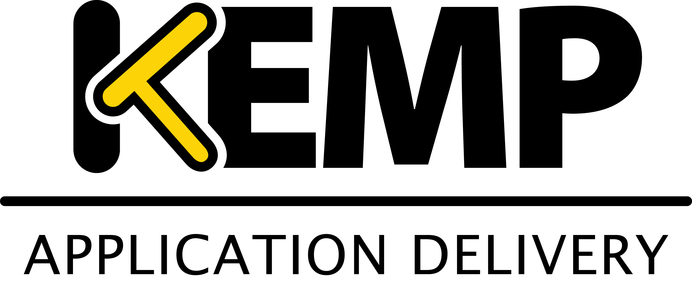


PowerShell Conference Asia
Dependencies, how to make them evident

Slide 2


About_Irwin
Blogging pshirwin.wordpress.com
GitHub irwins
Twitter @irwinstrachan
Contributor community.idera.com/powershell
PowerShell Conference
Singapore 2017
Irwin Strachan – Senior Consultant @Methos
Notes:
Here’s a quick list of how you can get in contact with me.

Slide 3
Agenda
Devs to OPS – You‘re doing it wrong!!!
Basic of Pester
Dependencies for better code
Arrange, Act & Assert
Demos
Comments
PowerShell Conference
Singapore 2017
Irwin Strachan – Senior Consultant @Methos

Slide 4
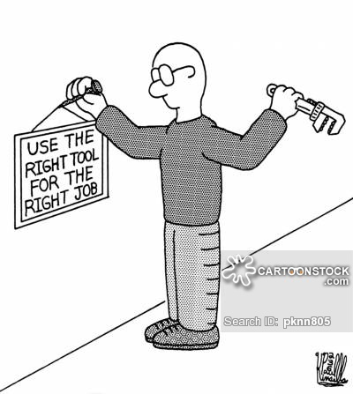
Dev to Ops – You’re doing it wrong!!!
PowerShell Conference
Singapore 2017
Irwin Strachan – Senior Consultant @Methos
Notes:
Question: How many use Pester for engineering rigor and precision?
Pester started making sense to me once I understood Operation Validation. Turns out Developers aren’t to giddy on OPS using their tools wrong.. Sure it gets the job done but that’s not what it’s really for. We can agree to disagree, but I get where Devs are coming from…

Slide 5
Dev to Ops – You’re doing it wrong!!!
Why are we (OPS) having a hard time getting “it”?
Why bother then?
Why are we (OPS) having a hard time getting “it”?
Why bother then?
PowerShell Conference
Singapore 2017
Irwin Strachan – Senior Consultant @Methos
Notes:
Why are we (OPS) having a hard time getting it?
OPS isn’t the same as Devs. Sure we automate stuff but we’re not in the business of developing software. We’ll create a script, refactor it ‘til it works and once we’re finished that’s the end of that! Now if you’re a toolmaker in your company, then yes, you need to consider some form of testing TDD or BDD. Developers use Tests to improve code quality, which will lead to more reliable software. Time for OPS to catch up!
Why bother then?
Speaking as an OPS guy, I find the assertion part quite useful. Maybe not as a full fledge developer, but there are certain parts OPS can use to their advantage… If we’re using it right… I’ll leave that up to you to decide…
OPS could stand to learn a thing or two from Devs. For Devs it’s all about being able to refactor their code and still make sure everything works as expected.

Slide 6
Back to Basics
What is a unit of code?
An isolated collection of code. A unit can be tested without loading or running the entire app.
What is a test?
Code whose purpose is to verify other code.
What is a testcase?
A set of inputs, one or more functional calls and an assertion about the expected output, which either passes or fails
What is a unit test
An assertion about a unit of code that can be verified deterministically
PowerShell Conference
Singapore 2017
Irwin Strachan – Senior Consultant @Methos
Notes:
I realize that I’ve been using Pester solely for OVF. I bought the Pester book Adam Betram to help me understand how to better implement test and learn better form so to speak… I may not always get it right but hey I’m trying…
What is a unit of code?
Think functions that do one thing and one thing only. Better to have 5 functions do one thing than the other way around…
What is a test?
This is It{ $var | -Should be } code part to verify expected output
What is a testcase?
Say you have a function Get-LargestNumber. Given a set a nr. You’d expect n a certain nr to be the largest. You’d create a bunch of these test to asses the outcome again and again…
Demo Get-LargestNumber
What is a unit test?
Again for the Get-LargestNumber test
That is, for a given input, you get the same output.

Slide 7
Demo refactoring code
Get-LargestNumber
PowerShell Conference
Singapore 2017
Irwin Strachan – Senior Consultant @Methos

Slide 8
What makes for a good test?
What makes for a good test?
Is the assertion verifiable?
Is the test coherent?
Are the inputs and outputs precisely specified?
Is the test readable?
Is it maintainable?
Are error cases considered?
Is it providing value, or is it more trouble than it’s worth?
PowerShell Conference
Singapore 2017
Irwin Strachan – Senior Consultant @Methos
Notes:
All these questions can also be applied to OPS just think Operation Validation instead of unit testing.

Slide 9
Demo Time!
Create AzureAD users from a CSV/XML File
Arrange – Act – Assert
Dependencies
PowerShell Conference
Singapore 2017
Irwin Strachan – Senior Consultant @Methos
Notes:
We’re going to do something we’ve all done create AD users
The easiest way to do this is Import-CSV … | New-ADUSer
However… We’re making quite some assumptions here…
We’re assuming that:
The file is available.
The manadatory Parameter is available
The ColumnNames are proper Parameters
The delimiter is correct (optional)
The encoding is known (optional)
"Arrange-Act-Assert“ a pattern for arranging and formatting code in UnitTest methods:
Each method should group these functional sections, separated by blank lines:
Arrange all necessary preconditions and inputs.
Act on the object or method under test.
Assert that the expected results have occurred.
You’re already doing this if you’ve ever written a script , you probably didn’t call it by that name.
So I read an interesting concept in the Pester book that I’d like to share with you guys…
Quick question How many parameters can New-ADUser take? The answer is 55. Name is Mandatory. Placing the csv file in a specific folder, filling and delimiting it properly is all part of the arrangement, getting things in place.
I created some trail & error scenarios just so you can see what can go wrong….
Show DuPSUGDemo-NewADUsers.ps1 – Go through each region
Using Pester to figure out if the CSV file is valid for creating users with New-ADUser is great idea!
It will save you the hassle in trying to figure why certain parameters aren’t accepted.
Show DescribeValidCSVFileForNewADUser.ps1
Explain why testing the csv file is a good idea. It makes for a better user experience the first time around. Change Column MobilePhone to Mobilephones and rerun.
Dependencies.
This I picked up from the Pester book. It’s a framework to help test assumptions you’ve made.
By thinking about them you recognize them and can actually test for them before getting started… Think of them as training wheels… Once all dependencies pass the test will the script be allowed to continue…
Show Dependencies test the outcome of running New-ADUser in It{}
That’s some pretty decent error handling. Was to be expected seeing is try{]catch{}
I wouldn’t have thought of using Pester this way… I’m not mad at it…
I’d be comfortable giving this to a junior… The errors are self-explanatory…

Slide 10
Takeaway
Pester is definitely useful from an OPS perspective
It can help OPS validate if input is precisely specified.
Dependencies helps recognizing the assumptions we’ve made.
If you’re a toolmaker you need to understand TDD/BDD
Make sure it adds value
Have fun Learning Pester!
PowerShell Conference
Singapore 2017
Irwin Strachan – Senior Consultant @Methos
Notes:
Summary
Writing scripts takes time, writing tests takes more time. If you released this script without tests, chances are you would not have considered trying to shuffle the numbers in the array. If this was sent to colleagues or put in production, you might get a Saturday 2am call to fix it.
You’d hammer out a solution, and you could still have edge cases that don’t work and worse, break parts that did work.
Developing the discipline for writing tests changes how you look at code and I believe makes you better scripter. Adding 14 lines of Pester isn’t difficult, and yes adding 14 lines of the right tests is challenging.
Ultimately, understanding how Test Driven Development (Design) can make you a more agile scripter will allow you to make an informed choice of using them or not.
The benefits don’t stop there. Here are more:
Other scripters can see if the script still works
As you build larger solutions and include these scripts, you want to make sure your foundation is sound
Tests can document how the target script can be used
Reduces the defect rate. Plus as you make changes over time, tests help to ensure things are working well
Let’s you ruthlessly refactor. In this example, the core logic was completely replaced with a built in PowerShell function, Measure-Object. As new versions of PowerShell are released, can you confidently replace your code with built-in solutions.

Slide 11
Questions
PowerShell Conference
Singapore 2017
Irwin Strachan – Senior Consultant @Methos

Slide 12
Don’t Forget!
Fill in your survey in Mobile app – it’s how we do better!
Don’t lose you badge! You need it for the Social Events
Grab the Speakers for a chat – they all have time for you!
Let everyone know what they are missing on Social Media
#PowerShell
#PSConfAsia
Photos of Marina Bay Credit: Sebastian Szumigalski
PowerShell Conference
Singapore 2017

